Slide 1


Introduction to Digital Systems
EGR 226
Lecture_2
Dr. Nabeeh Kandalaft EGR226 Grand valley State University

Slide 2
Objectives for today’s lecture
After today’s lecture you should be able to:
Explain the difference between a microprocessor and a microcontroller
Describe how to select a controller for your application
Describe the major architectural features of the MSP432
Describe how a program is edited, compiled, linked, and loaded using an IDE
Dr. Nabeeh Kandalaft EGR226 Grand valley State University

Slide 3

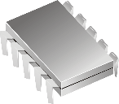
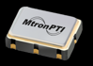
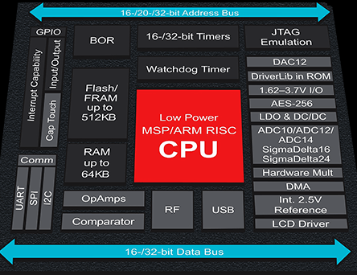
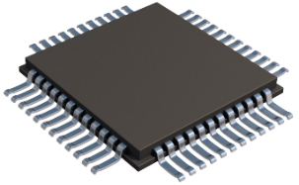
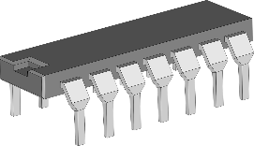
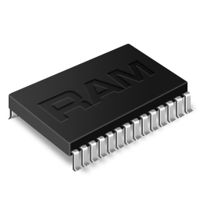
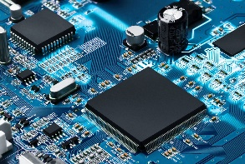
Microprocessor or Microcontroller?
A microprocessor needs other components before it can be used
A microcontroller has these parts integrated on the chip
BOR
Brown Out Reset
Microprocessor
Oscillator
0-48MHz
Program
Memory
A/D
convertor
RAM
LCD Driver
Dr. Nabeeh Kandalaft EGR226 Grand valley State University
Notes:
A brownout reset is a circuit that causes a computer processor to reset (or reboot) in the event of a brownout, which is a significant drop in the power supply output voltage

Slide 4
Microcontroller Architecture
A microcontroller is a sequential logic digital circuit.
It has a clock, it has digital inputs, it has digital outputs.
It’s like a counter, or a shift register, except that it can do a lot more than these dedicated devices.
Applications where a lot of computing power or speed are required, such as modern PC’s, require a microprocessor
Microcontrollers makeup 99% of computing devices in use today.
low power consumption
low cost (MSP432 $2.15 @ 1000 piece quantities)
modest speed of operation (10’s of MHz, not GHz)
integrated peripherals for small total system size

Slide 5
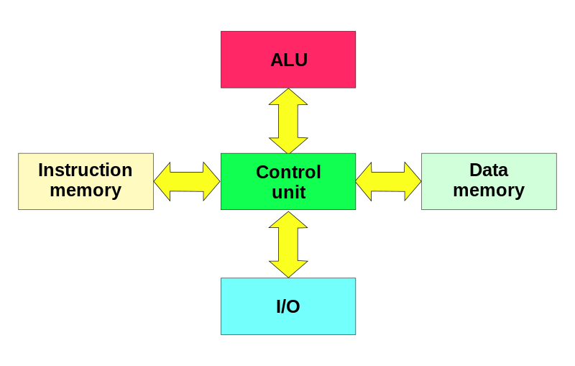
Microcontroller Architecture
Harvard Architecture
Separate memories for data and instructions.
Two sets of address/data buses between CPU and memory
EEPROM (“flash”)
non-volatile
SRAM
volatile
Dr. Nabeeh Kandalaft EGR226 Grand valley State University
Notes:
comes from the Harvard Mark I relay-based computer
stored instructions on punched tape (24 bits wide) and data in electro-mechanical counters.

Slide 6
Microcontroller Architecture
Microcontrollers contain:
Small programs (flash memory)
Small (SRAM) memory,
Harvard architecture (concurrent instruction and data access.)
Program and Data memories may feature :
Different bit widths, e.g., using 16-bit wide instructions and 8-bit wide data
Different memory technologies, e.g., flash for instructions and RAM for data
Instruction pre-fetch can be performed in parallel with other activities.
Most microprocessors use a Von Neumann architecture where instructions and data use the same memory (and bus)

Slide 7
Microcontroller Architecture
Microcontrollers use a RISC architecture
• CISC (Complex Instruction Set Computer)
e.g., Intel X86 (a microprocessor)
• RISC (Reduced Instruction Set Computer, “reduced” in complexity)
e.g., MIPS, AVR, PIC, ARM
CISC attempts to minimize the number of instructions per program, with multiple cycles per instruction.
RISC reduces the cycles per instruction (often 1) at the cost of the number of instructions per program
The reduced price of RAM and the increased compiler sophistication has favored adoption of RISC

Slide 8
Microcontroller Types
ARM e.g., ARM Cortex-M 32 bit RISC
licensed technology
high end embedded, e.g., cell phones, routers
entering low cost, low power market
Atmel AVR 8, 16, 32 bit RISC
architecture lends itself to C programming
Microchip Technology PIC (RISC)
originally Peripheral Interface Controller
simple architecture, memory addressing can be difficult
Texas Instruments MSP432 (RISC)
focus on low power applications
Parallax Propeller (RISC)
multiple cores on chip run in parallel (robotics controller)
Intel MCS-51 (also referred to as 8051, scaled down CISC)
old design, but, IP cores still popular

Slide 9
Selecting a Microcontroller
Guidelines in selecting a microcontroller
Availability
who sells it?
is it in stock?
Price (differences are closing)
Power consumption (MSP430/MSP432 has advantage here)
Features necessary for your project (speed, memory, peripherals)
Development tools (C compiler? simulator? free or not? in-circuit debugger? emulator? ARM, AVR has advantage here)
Familiarity (saves on re-training time and costs)
Support (both from the manufacturer and the Internet)
Packaging (DIP vs. surface-mount) and number of pins

Slide 10
Microcontroller Choices, Why ARM?
Summary
ARM founded in November 1990 as Advanced RISC Machines
Company headquarters in Cambridge, UK
Processor design centers in Cambridge, Austin
ARM technology is in use in 95% of smart phones, 80% of digital cameras, and 35% of all electronic devices (ARM company profile, 2015).
ARM is choice for about 90% of 32-bit embedded systems and is making in-roads in the 8-16 bit low cost, energy efficient embedded applications
licensed to many Si manufacturers (multiple sources, price and feature competition)
configurable, scales with need (from multicore smart phones to small low power, low cost embedded)
16 and/or 32 bit architecture was more expensive than 8-bit architecture
complexity of RTOS and availability of Ethernet, wireless, USB controllers and stacks
Dr. Nabeeh Kandalaft EGR226 Grand valley State University

Slide 11
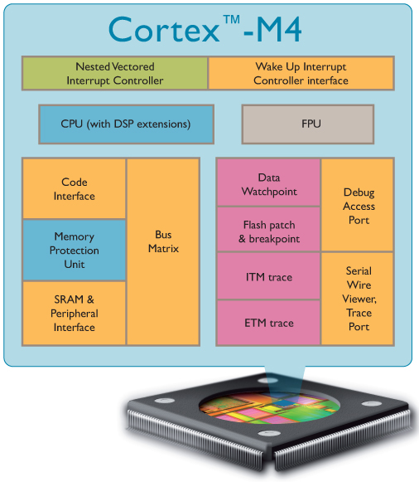
Cortex-M4
ARMv7E-M Architecture
DSP extensions
Optional FPU (Cortex-M4F)
Fully programmable in C
3-stage pipeline
Fixed memory map
1-240 interrupts
Configurable priority levels
Non-Maskable Interrupt support
Debug and Sleep control
Serial wire or JTAG debug
Cortex M3 Total 60k* Gates

Slide 12
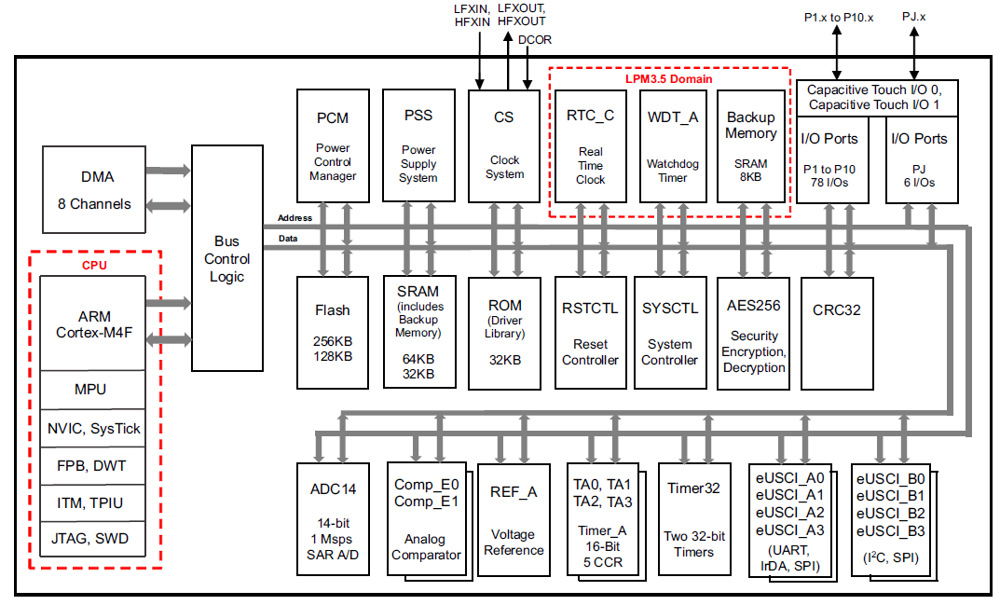
MSP432 Functional Block Diagram

Slide 13
MSP432 Architecture
M
i
c
r
o
c
o
n
t
r
o
l
l
e
r
S
y
s
t
e
m
b
u
s
A
R
M
®
C
o
r
t
e
x
T
M
-
M
p
r
o
c
e
s
s
o
r
I
n
p
u
t
p
o
r
t
P
P
B
s
I
n
t
e
r
n
a
l
p
e
A
d
v
a
n
c
e
d
r
i
p
h
e
r
a
l
s
H
O
u
t
p
u
i
g
h
-
p
e
r
f
t
B
u
s
p
o
r
t
s
I
n
s
t
r
u
c
t
i
o
n
s
F
l
a
s
h
R
O
M
D
a
t
a
I
C
o
d
e
b
u
s
D
C
o
d
e
b
u
s
R
A
M
for debugging
Harvard architecture
Separate busses for instructions and data
Additional busses
Private Peripheral, System, Advanced High Performance
Even though data and instructions are fetched 32-bits at a time, each 8-bit byte has a unique address. This means memory and I/O ports are byte addressable
Dr. Nabeeh Kandalaft EGR226 Grand valley State University

Slide 14
MSP432 Architecture
Internal Registers
R
0
R
1
R
2
R
3
R
4
G
e
n
e
r
a
l
R
5
Each register is a collection of D-flipflop
p
u
r
p
o
s
e
R
6
Registers are directly accessible by the CPU
r
e
g
i
s
t
e
r
s
R
7
R
8
R
9
R
1
0
R
1
1
R
1
2
S
t
a
c
k
p
o
i
n
t
e
r
R
1
3
(
M
S
P
)
Branching to subroutine
L
i
n
k
r
e
g
i
s
t
e
r
R
1
4
(
L
R
)
P
r
o
g
r
a
m
c
o
u
n
t
e
r
R
1
5
(
P
C
)
No need to go out over a bus to get or save intermediate results
Provides much more efficient (faster) programs
Dr. Nabeeh Kandalaft EGR226 Grand valley State University

Slide 15
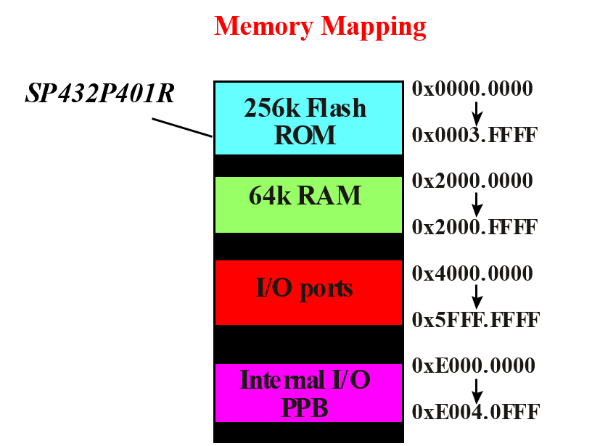
MSP432 Architecture
Each type of memory has its own separate set of addresses
Addresses are also used to read and write to I/O ports
I/O registers are treated as memory locations
MSP432P401R
0X0000.0000
0X0003.FFFF
0X2000.0000
0X2000.FFFF
0X4000.0000
0X5FFF.FFFF
0XE000.0000
0XE004.0FFF
RAM used
for variables
Dr. Nabeeh Kandalaft EGR226 Grand valley State University

Slide 16
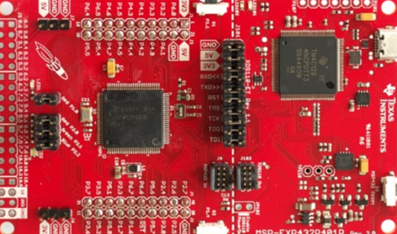
32-bit, 48MHz Cortex-M4F processor
Memory - 256kB flash, 64kB of SRAM, and 32KB of ROM preloaded with MSPWare Driver Libraries
Voltage: 1.62V to 3.7V
Current: Less than 1uA while running with RTC, Active is 90uA/MHz
Timers - 4x 16-bit timers, 2x 32-bit timers.
Serial - 4x eUSCI_B modules with I2C/SPI and 4x eUSCI_A modules with UART/SPI/IrDA.
78 GPIO (67 available) - All IOs can generate an Interrupt, all can drive up to 6mA, and 4 of them can drive up to 20mA. 24 of the pins support pin mapping.
Analog - 14-bit 1MSPS ADC with an internal voltage reference and 2 comparators.
Hardware Accelerators for AES (Advanced Encryption Standard)
CRC ( cyclic redundancy check)
Built-In DC/DC converter or LDO option reduces operating and sleep current consumption by 40%.
2x buttons
+ reset button,
1 red LED
, and one RGB LED
Dr. Nabeeh Kandalaft EGR226 Grand valley State University
Notes:
Short for cyclic redundancy check, a common technique for detecting data transmission errors. Transmitted messages are divided into predetermined lengths that are divided by a fixed divisor. According to the calculation, the remainder number is appended onto and sent with the message. When the message is received, the computer recalculates the remainder and compares it to the transmitted remainder. If the numbers do not match, an error is detected.
The Advanced Encryption Standard, or AES, is a symmetric block cipher chosen by the U.S. government to protect classified information and is implemented in software and hardware throughout the world to encrypt sensitive data.

Slide 17
GPIO Review
Dr. Nabeeh Kandalaft EGR226 Grand valley State University

Slide 18
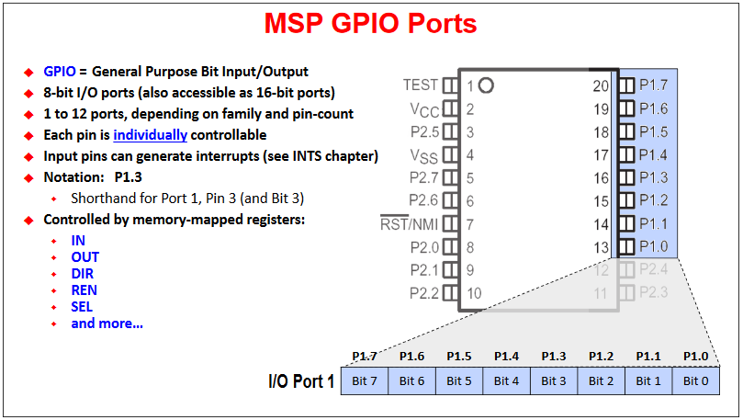
GPIO Review
* TI training slide

Slide 19
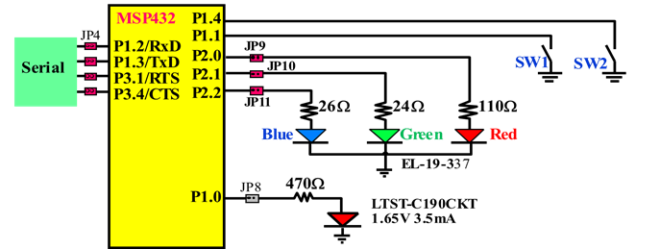
I/O Ports and Control Registers
Memory mapped I/O macro
Initialization
Clear PxSEL0, PxSEL1 Bits to 0 for regular input output pins
Set PxDIR Register to 1 for output or 0 for input
Set PxOUT Register to 1 for HIGH or 0 for LOW
Input from pin Read PxIN
(where X is the port number)
X ➔ 1 - 10
Dr. Nabeeh Kandalaft EGR226 Grand valley State University

Slide 20
Partial Table of Alternate Pin Functions
Default Primary Secondary Tertiary
Pin | PxSEL1=0, PxSEL0=0 | PxSEL1=0, PxSEL0=1 | PxSEL1=1, PxSEL0=0 | PxSEL1=1, PxSEL0=1
P1.0 | Port | UCA0STE
P1.1 | Port | UCA0CLK
P1.2 | Port | UCA0RXD/UCA0SOMI
P1.3 | Port | UCA0TXD/UCA0SIMO
P1.4 | Port | UCB0STE
P1.5 | Port | UCB0CLK
P1.6 | Port | UCB0SIMO/UCB0SDA
P1.7 | Port | UCB0SOMI/UCB0SCL
P2.0 | Port | UCA1STE
P2.1 | Port | UCA1CLK
P2.2 | Port | UCA1RXD/UCA1SOMI
P2.3 | Port | UCA1TXD/UCA1SIMO
P2.4 | Port | TA0.CCI1Aª / TA0.1^{b}
P2.5 | Port | TA0.CCI2Aª / TA0.2^{b}
P2.6 | Port | TA0.CCI3Aª / TA0.3^{b}
P2.7 | Port | TA0.CCI4Aª / TA0.4^{b}
P3.0 | Port | UCA2STE
P3.1 | Port | UCA2CLK
P3.2 | Port | UCA2RXD/UCA2SOMI
P3.3 | Port | UCA2TXD/UCA2SIMO
P3.4 | Port | UCB2STE
P3.5 | Port | UCB2CLK
P3.6 | Port | UCB2SIMO/UCB2SDA
P3.7 | Port | UCB2SOMI/UCB2SCL
P4.0 | Port |  |  | A13
P4.1 | Port |  |  | A12
P4.2 | Port | ACLK^{b} | TA2CLKª | A11
P4.3 | Port | MCLK^{b} | RTCCLK^{b} | A10
P4.4 | Port | HSMCLK^{b} | SVMHOUT^{b} | A9
P4.5 | Port |  |  | A8
P4.6 | Port |  |  | A7
P4.7 | Port |  |  | A6
MUX bits of
PxSEL0 & PxSEL1
General Purpose I/O
0
Table 4.1 in Valvano’s textbook
Primary Module Function
1
Secondary Module Function
2
Tertiary Module Function
3
Pin of Chip
SEL1 and SEL0 bits on the MSP432 specify alternate functions.
P1.2 and P1.3 are hardwired to the serial port to USB interface.
Dr. Nabeeh Kandalaft EGR226 Grand valley State University

Slide 21
Sample I/O code
Look ma- no headers!
void delay(void);
void main(void)
{
*((unsigned short*) 0x40004C0A) = 0x5A80;
*((unsigned short*) 0x40004C0C) = 0x5A80;
*((unsigned short*) 0x40004C04) |= 0x0001;
while(1)
{
*((unsigned short*) 0x40004C02) &= ~0x0001;
delay();
*((unsigned short*) 0x40004C02) |= 0x0001;
delay();
}
}
void delay(void)
{
volatile unsigned int x;
for(x = 0; x<10000; x++);
}

Slide 22
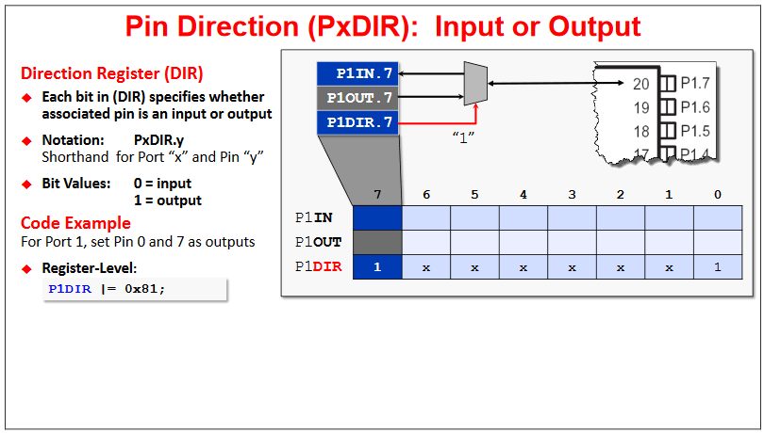
Input or Output?
* TI training slide

Slide 23
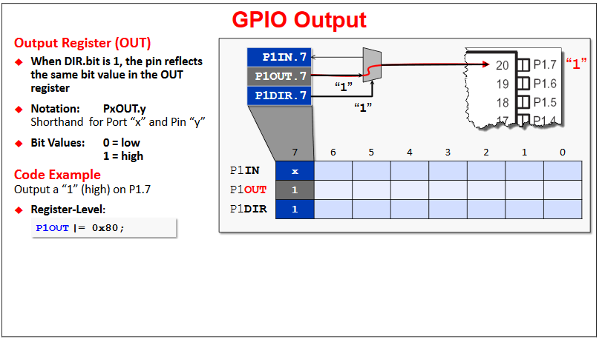
Setting an Output
* TI training slide

Slide 24
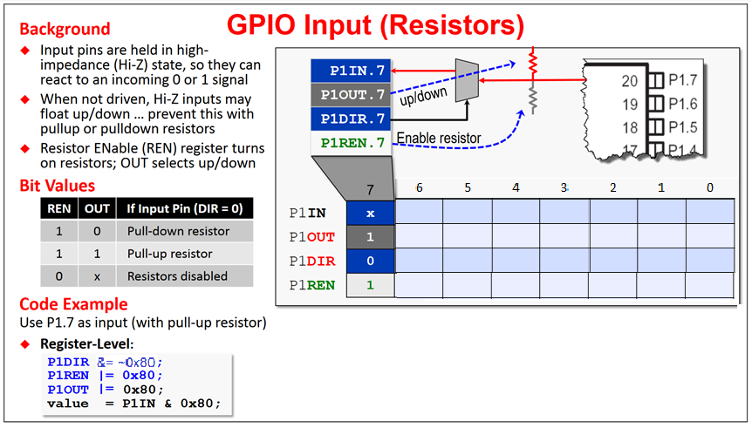
Reading an Input
* TI training slide

Slide 25
Procedure for Using Standard I/O
Initialization (executed once at beginning)
Clear PxSEL0 and PxSEL1 to select GPIO
Set PxDIR to 0 for input, 1 for output
Set PxREN to 1 to enable internal resistor
Set PxOUT to 1 for pull-up
Set PxOUT to 0 for pull-down
(internal R is approx. 35K)
Example:
P
o
s
i
t
i
v
e
l
o
g
i
c
,
i
n
t
e
r
n
a
l
+
3
.
3
V
MSP432
i
n
P
2
.
6
P
u
l
l
d
o
w
n
R
E
N
=
1
r
e
s
i
s
t
o
r
O
U
T
=
0
N
e
g
a
t
i
v
e
l
o
g
i
c
,
i
n
t
e
r
n
a
l
+
3
.
3
V
P
u
l
l
u
p
R
E
N
=
1
r
e
s
i
s
t
o
r
i
n
O
U
T
=
1
P
1
.
6
M
S
P
4
3
2
void Port1_Initb(void)
{
P1SEL0 &= ~0x12;
P1SEL1 &= ~0x12; // 1) configure P1.4 and P1.1 as GPIO
P1DIR &= ~0x12; // 2) make P1.4 and P1.1 inputs
P1REN |= 0x12; // 3) enable pull resistors on P1.4 and P1.1
P1OUT |= 0x12; // P1.4 and P1.1 are pull-up
}
uint8_t Port1_Input(void){
return (P1IN&0x12); // read P1.4,P1.1 inputs
}
P1.4 P1.1
0 0 0 1 0 0 1 0
0x12
Dr. Nabeeh Kandalaft EGR226 Grand valley State University

Slide 26

Building the Project
USB JTAG Connection
a program Code Composer Studio (CCS) is running on the desktop to provide a convenient interface to an editor, the compiler, assembler, and linker
A Makefile is auto generated by the IDE to run the build process
A dedicated MCU on the Launchpad board is preprogrammed with the TI debug protocol and implements a composite USB device consisting of:
ming and debugging interface
a virtual COM port that provides a link between a COM port registered on the host PC and a USART RX-TX pin pair on the target chip (MSP432) on the board

Slide 27
Simple Program to Toggle I/O Pin
#include "msp.h"
#include <stdint.h>
void main(void) {
volatile uint_32 i ;
WDT_A->CTL = WDT_A_CTL_PW | WDT_A_CTL_HOLD; // stop watchdog timer
P1->DIR |= BIT0 ; // P1 set as an output
while(1)
{
P1OUT ^= BIT0 ; // blink P1.0 LED
for ( I = 20000; I > 0; i--) ; // Delay
}
}
WDTCTL = WDTPW | WDTHOLD; // Stop watchdog timer
P1DIR |= BIT0 ;

Slide 28
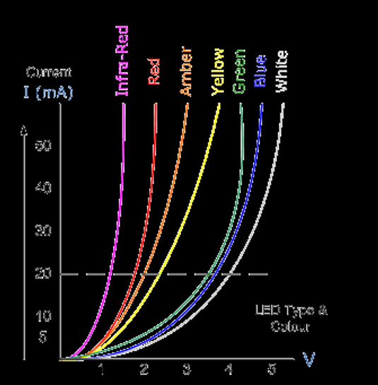

Prelab Design of LED Interface
Design a proper interface to drive a LED from a port pin on the MSP432
Forward
Characteristics
Infra-Red
Amber
Green
Forward
Current
Red
Yellow
White
Blue
Specified
Voltage
10mA
50
40
30
20
10
0
Current
2V
Voltage
Reverse
Breakdown
LED current v. voltage
LED Type and Color
Brightness = power = V*I
V
0 1 2 3 4 5
anode (+)
cathode (-)
Dr. Nabeeh Kandalaft EGR226 Grand valley State University

Slide 29
Setting the I/O Direction
R
e
a
d
f
r
o
m
P
x
I
N
R
e
a
d
f
r
o
m
P
x
I
N
n
n
R
e
a
d
f
r
o
m
P
x
O
U
T
R
e
a
d
f
r
o
m
P
x
O
u
P
r
o
c
e
s
s
o
r
P
r
o
c
e
s
s
o
r
t
n
n
n
n
D
Q
O
u
t
p
u
t
P
o
r
t
D
Q
I
n
p
u
t
P
o
r
t
W
r
i
t
e
t
o
P
x
O
U
T
W
r
i
t
e
t
o
P
x
O
U
T
1
0
D
Q
D
Q
B
u
s
B
u
s
W
r
i
t
e
t
o
P
x
D
I
R
W
r
i
t
e
t
o
P
x
D
I
R
The input/output direction of a bidirectional port is specified by its direction register.
PxDIR ………. Specify if corresponding pin is input or output:
0 means input
1 means output
Dr. Nabeeh Kandalaft EGR226 Grand valley State University

